Slide 1
Analyzing CRISPR IO Screens Using Clinical Biomarker Data
Brendan J. lee
Pfizer Summer student, Computational biology

Slide 2
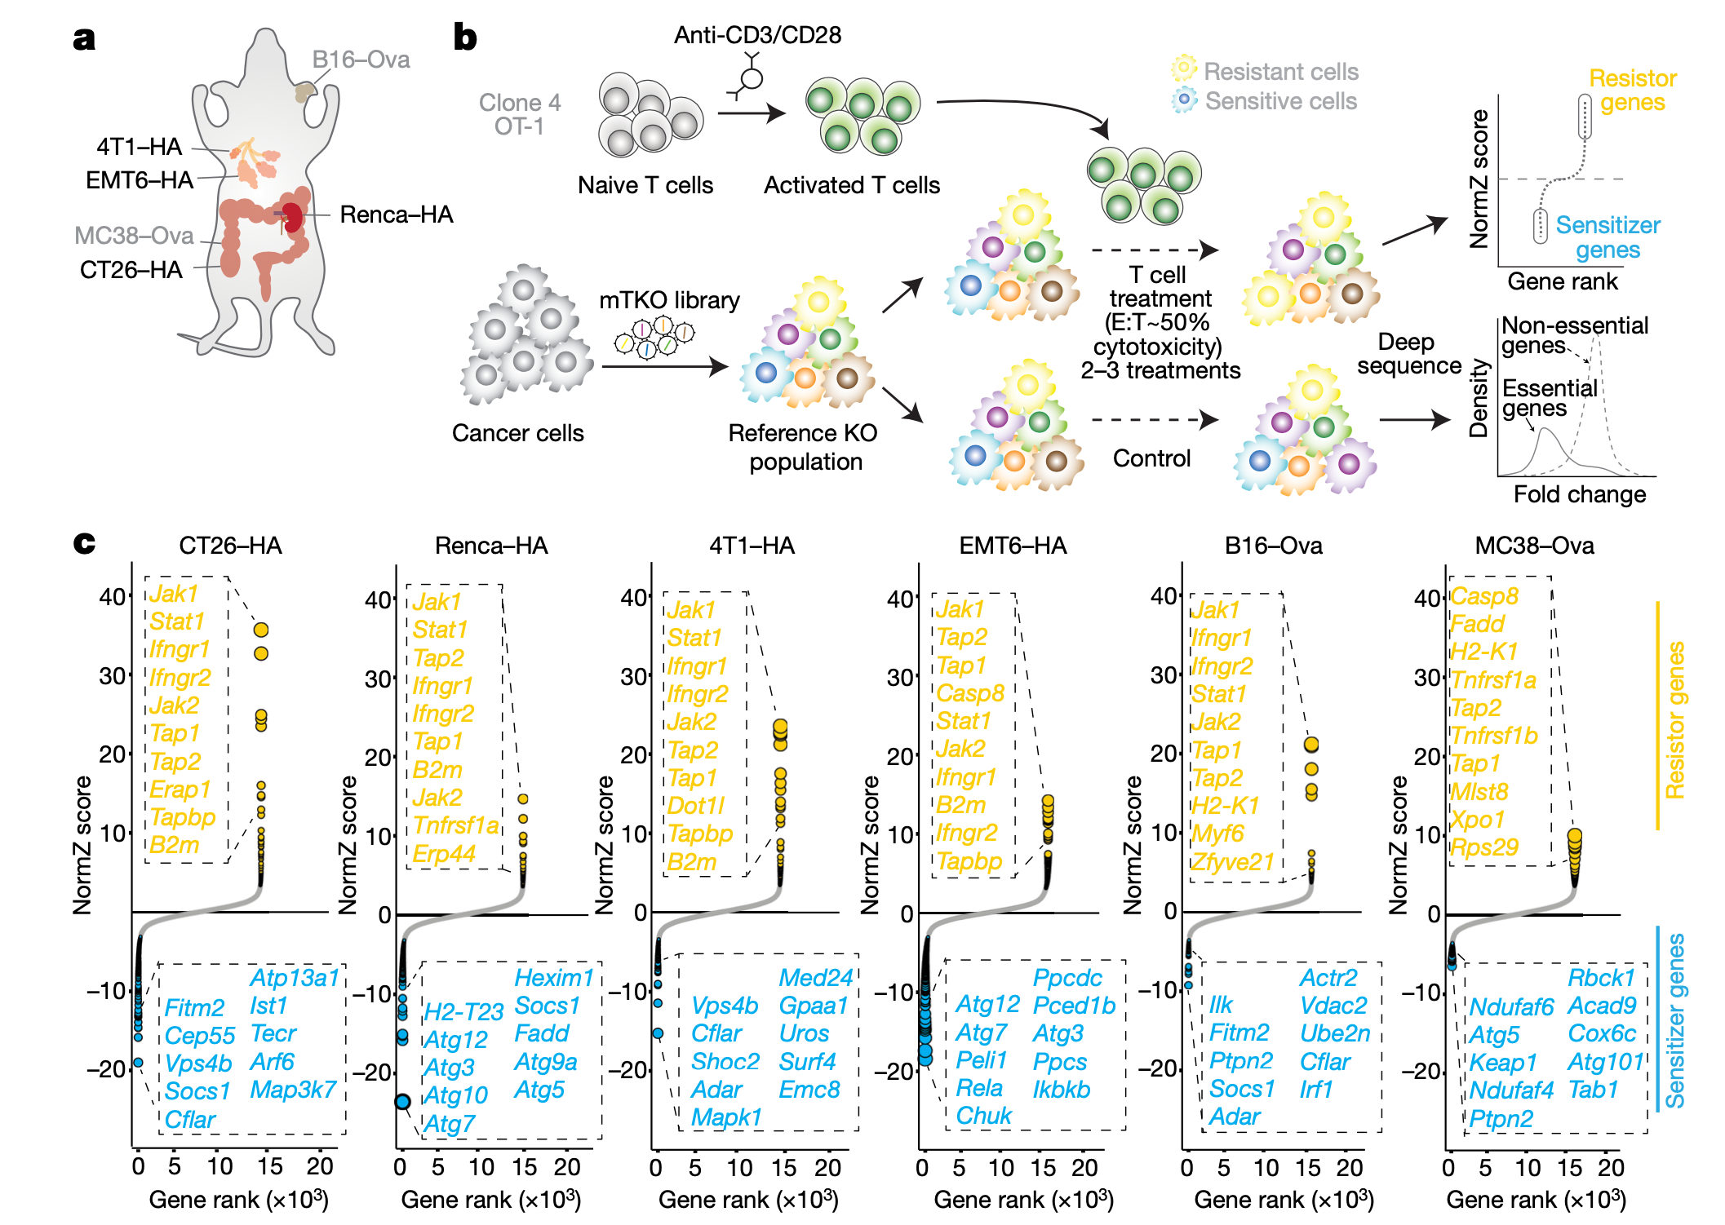
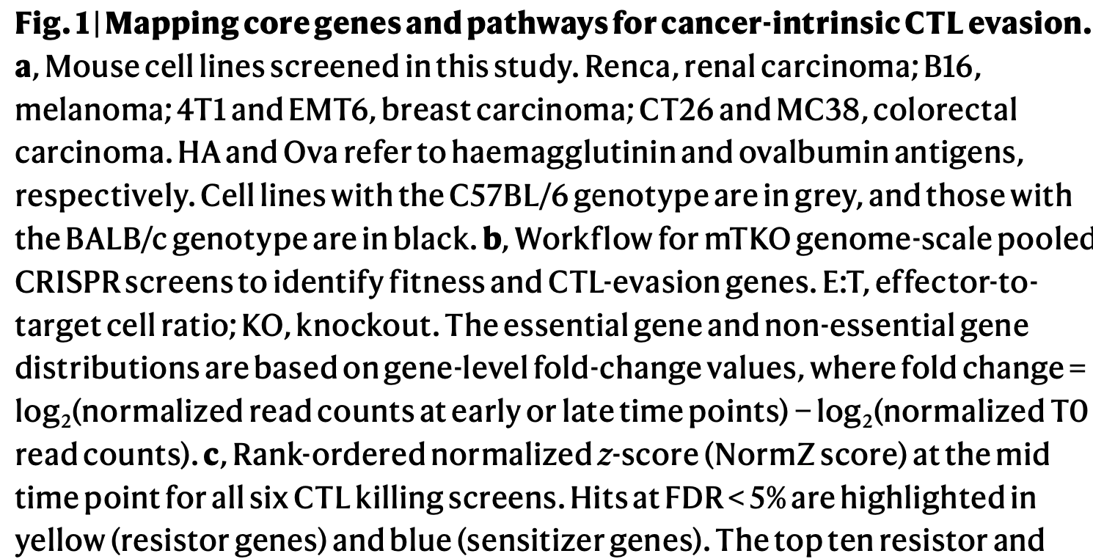
CRISPR screens in immune assays
https://doi.org/10.1038/s41586-020-2746-2

Slide 3
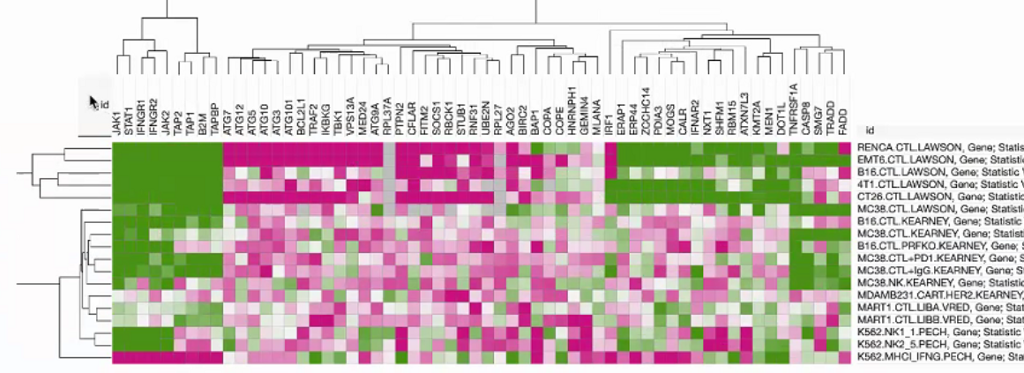
Aggregated view of CRISPR screens for IO Therapies, on Data4Cure

Slide 4
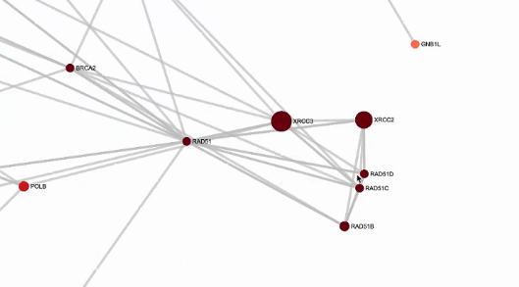
Network View of Internal CRISPR Screens in D4C
Notes:
RAD5 is associated with PARP inhibitors

Slide 5
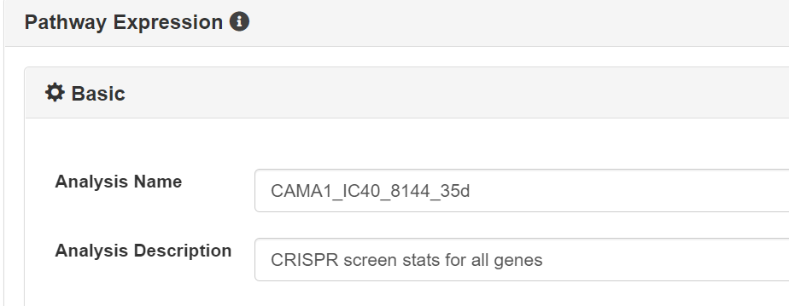
Pipeline to Add Each Screen to the Resource
Obtain .txt file that contains the p-value and z-score for each gene in the CRISPR screen for a certain treatment, either from publicly available tables or from the wsk-21 server
Calculate fdr and foldchange for each file, creating new columns
Transform file into Data4Cure format (.tbl)
Run Pathway Expression on D4C, and add analysis to aggregated resource

Slide 6
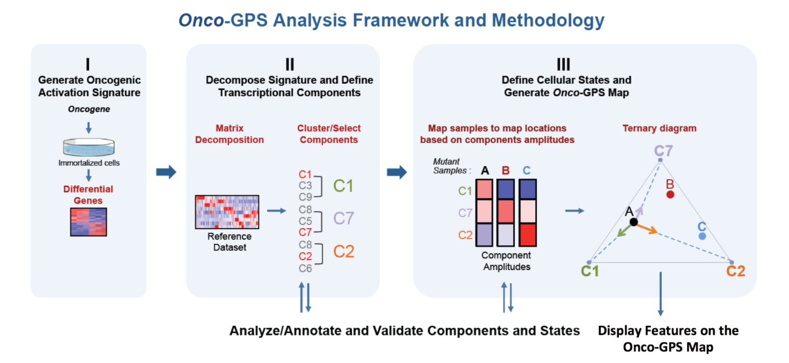

Slide 7
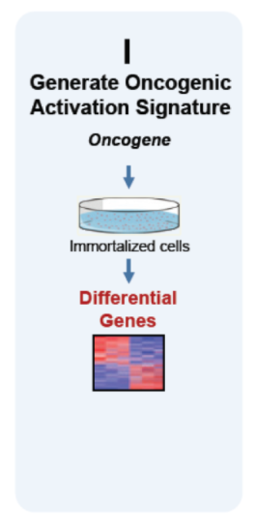
Replace KRAS Signature in Original Code with two different IO gene lists
191 positive hits on D4C IO CRISPR screens (genes with significant p-value in the positive direction for at least 4 screens, or rows in aggregated resource on Slide 3)
490 negative hits on D4C IO CRISPR screens (genes with significant p-value in the negative direction for at least 4 screens)

Slide 8
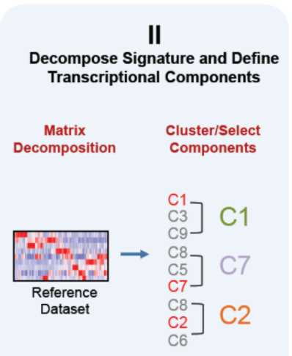
For each gene list perform NMF on gene expression data
First used the CCLE gene expression table as in the original OncoGPS code
This analyzed expression of IO genes in tumor cell lines
Then replaced CCLE table with the gene expression table from study B9991003, a clinical study
This analyzed expression of IO genes in tumor samples
The optimal number of components was selected by examining the plot of cophenetic correlation coefficient (CCC) vs. number of components (K)

Slide 9
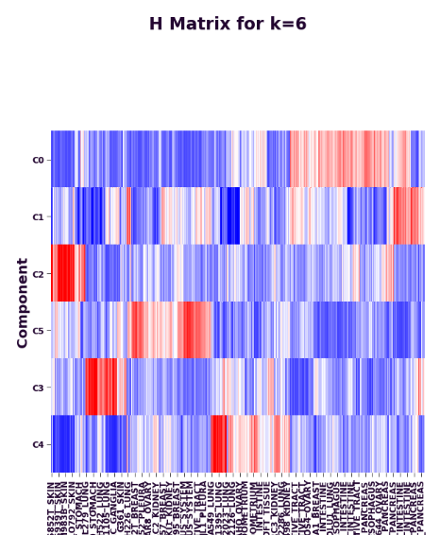
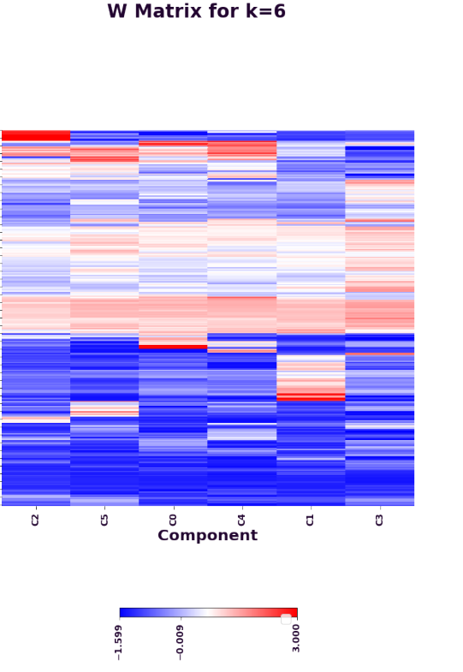
NMF on CCLE Expression Table (using private gene list, rows hidden in W matrix)

Slide 10
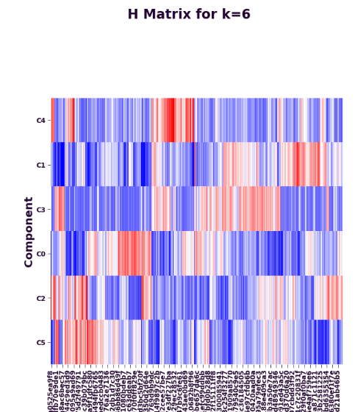
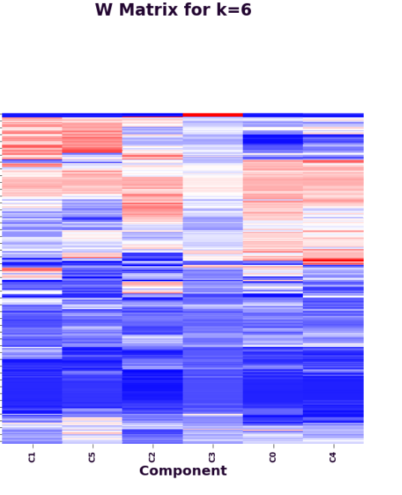
NMF on B9991003 Expression Table (using private gene list, rows hidden in W matrix)

Slide 11
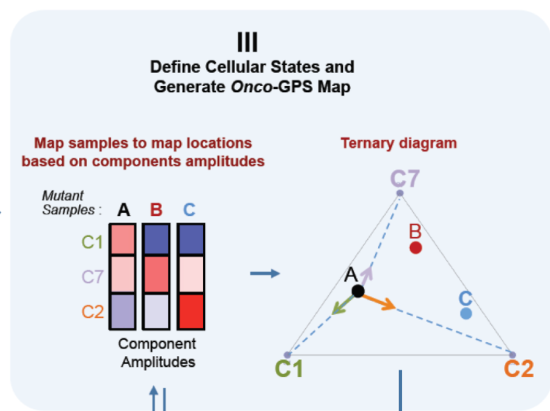
Clustering samples and generating the Onco-GPS Map
Columns in each H matrix outputted by the previous step (CCLE cell lines or individual clinical samples) were clustered into phenotypes, only using independent components (a subset of 3 or 4 of the original components)
Ccal’s define_states method was used to cluster samples into phenotypes
CCC vs. K was used again to determine optimal K, or number of phenotypes/clusters for the given samples
For CCLE, multiple subsets of cell lines were filtered for (non-small cell lung, small-cell lung, and breast cell lines)
A table of each sample and its corresponding phenotype was outputted for each run

Slide 12
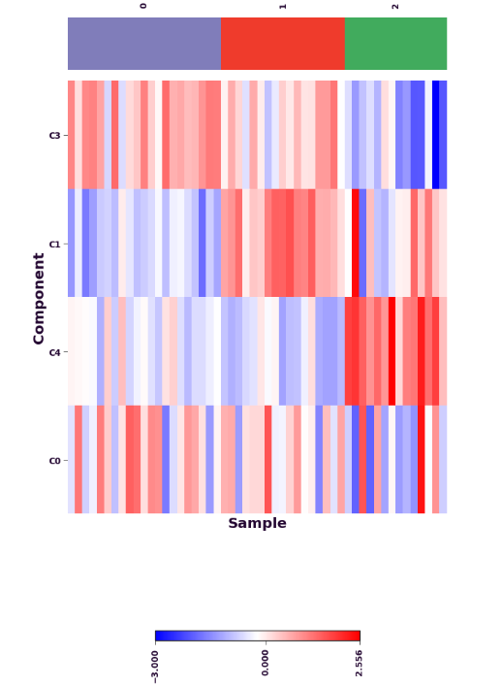
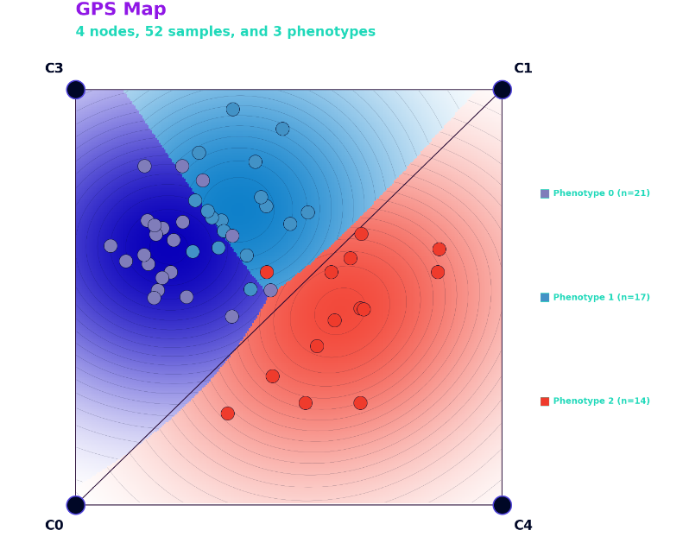
Clustering of the CCLE Small Cell Lung Carcinoma (SCLC) Lines in the H matrix for private gene list, and Displaying the OncoGPS Map

Slide 13
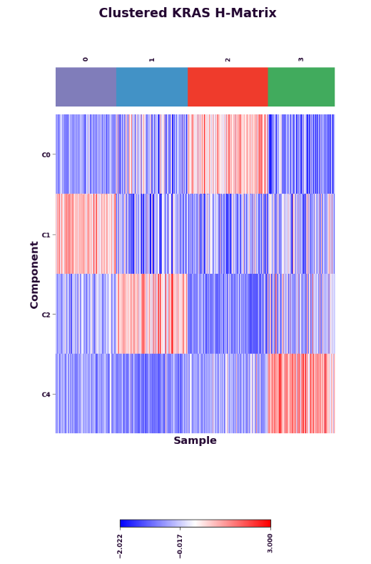
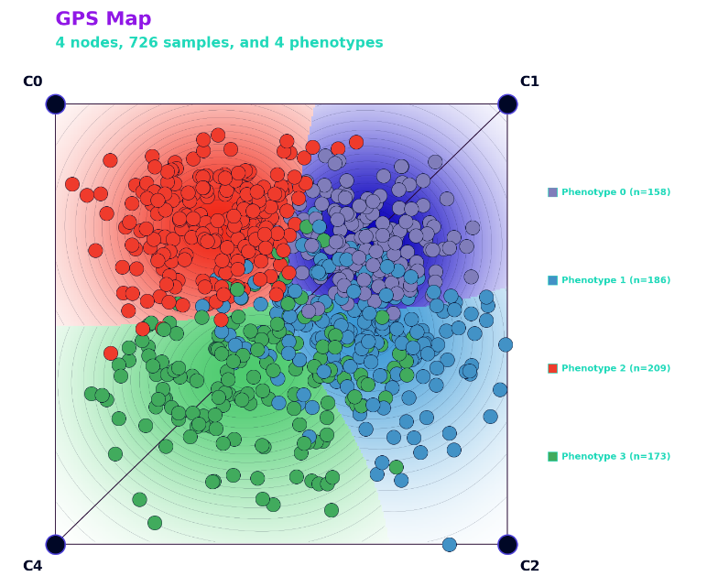
Clustering of the B9991003 samples in the H matrix for private gene list, and Displaying the OncoGPS Map
P2 P3 P0 P1
Phenotype 2 (n=158)
Phenotype 3 (n=186)
Phenotype 0 (n=209)
Phenotype 1 (n=173)

Slide 14
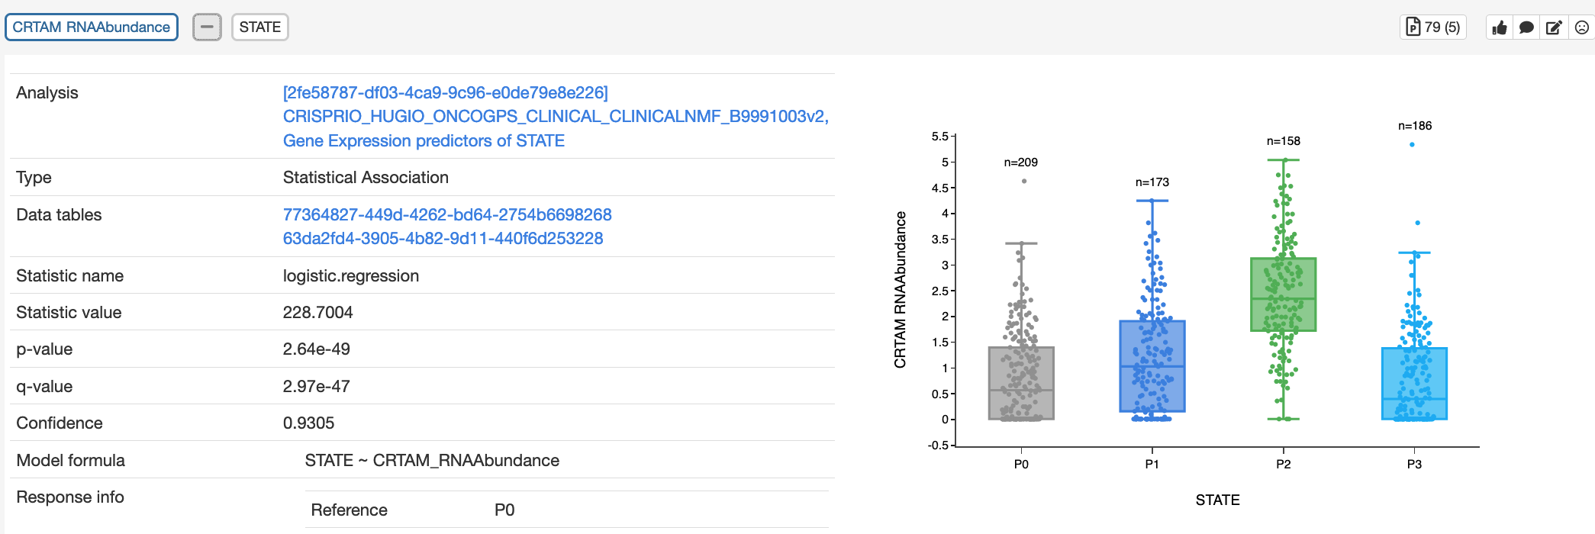
CRTAM is abundant in P2, Consistent with NMF Results in which P2 is high in C1

Slide 15
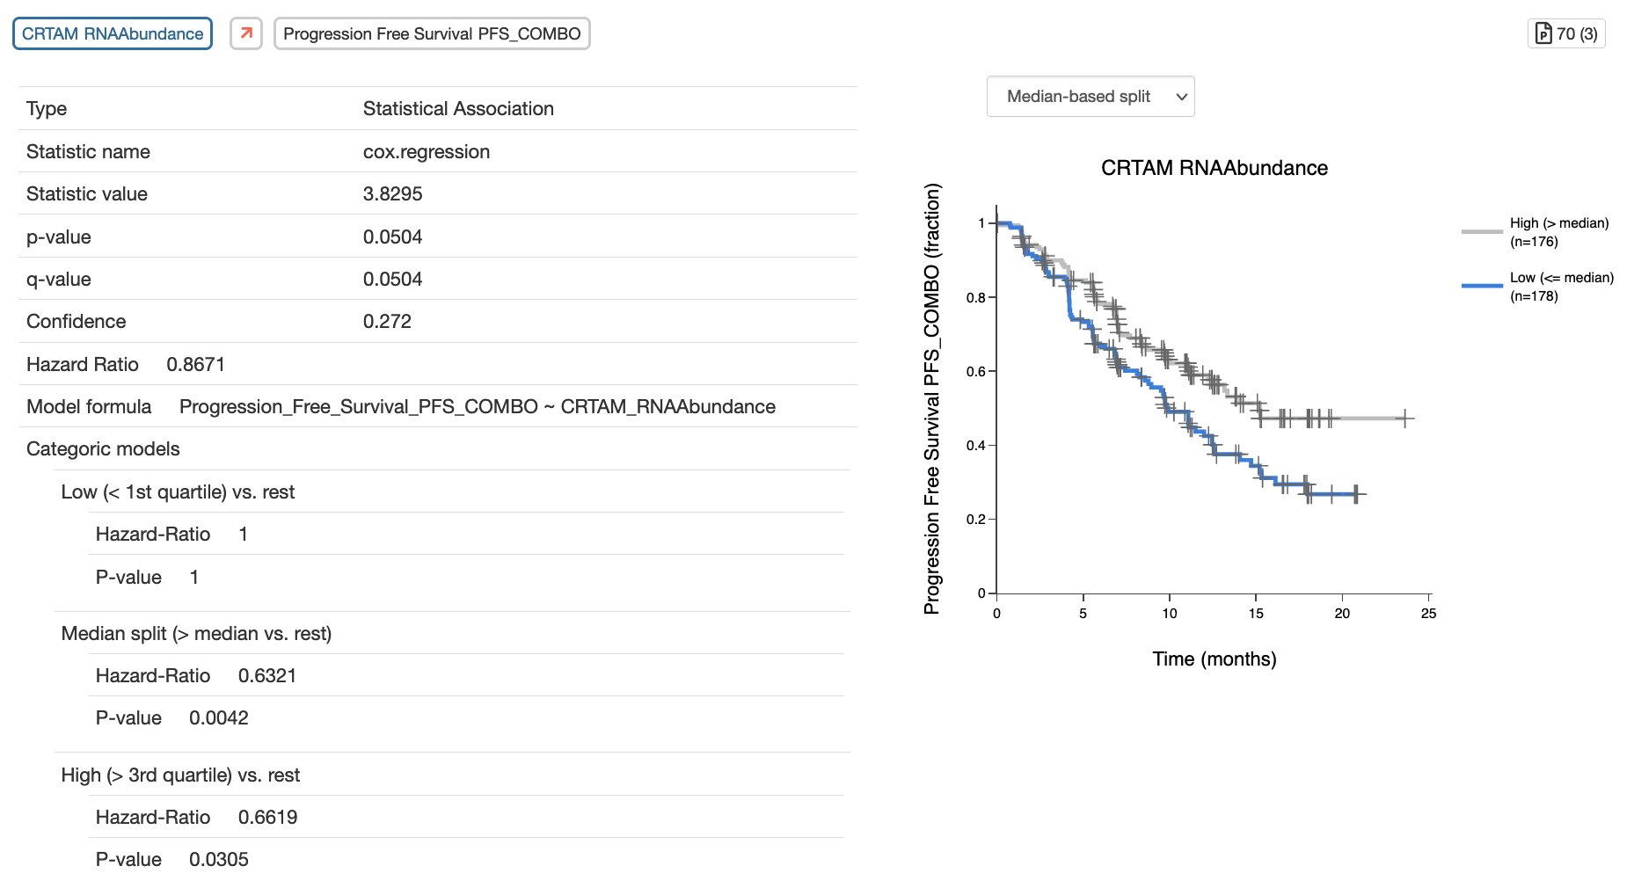

Slide 16
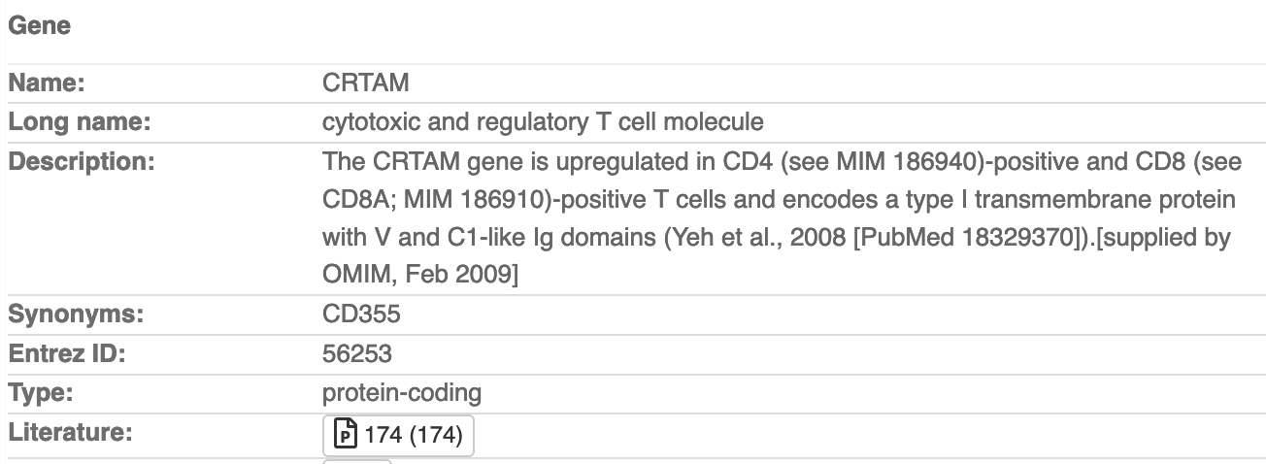
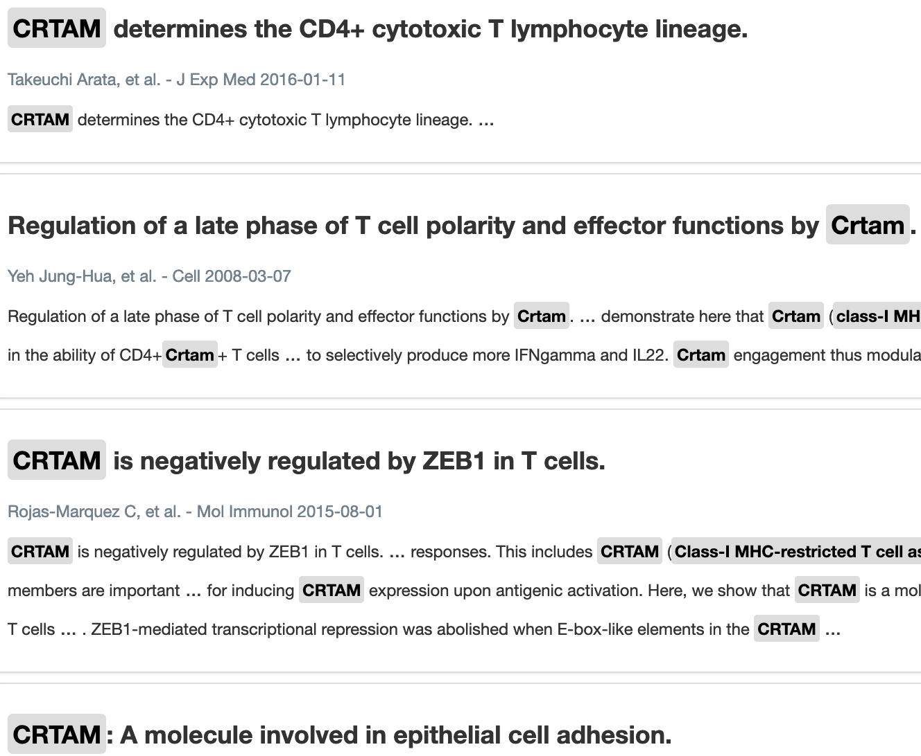

Slide 17
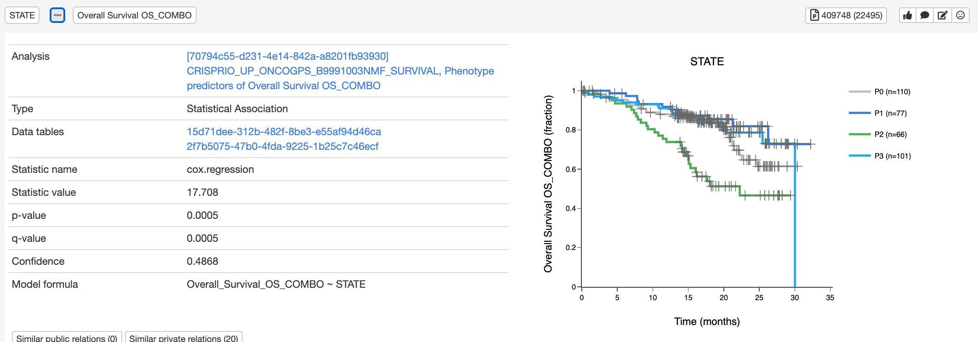
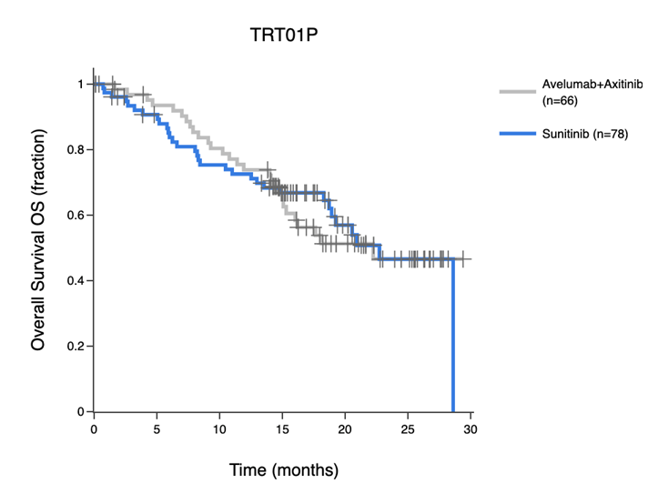
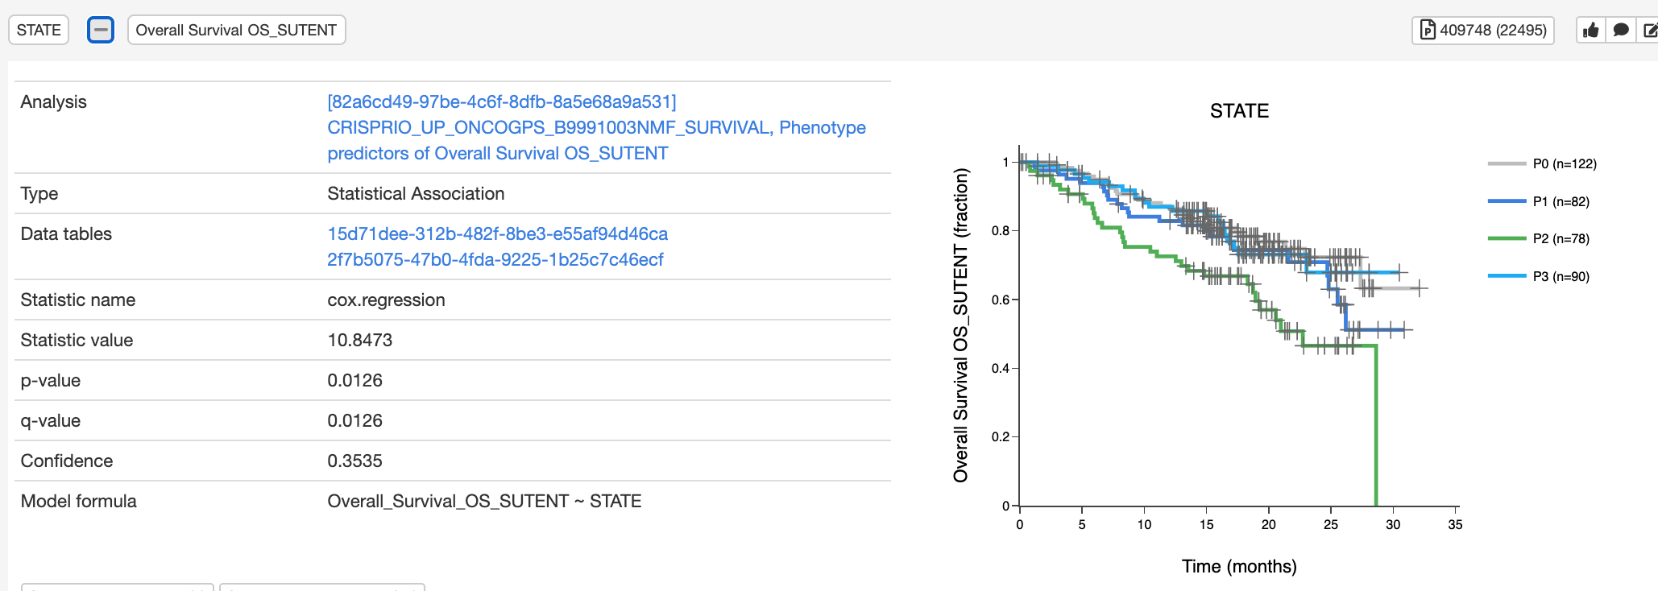
Survival of Each Phenotype for Up List
P2 only
Notes:
-P2 is low for both IO and SUTENT treatmentssss

Slide 18


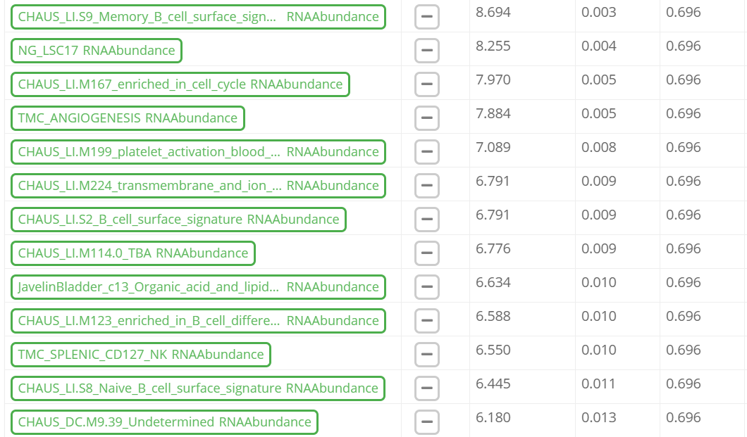


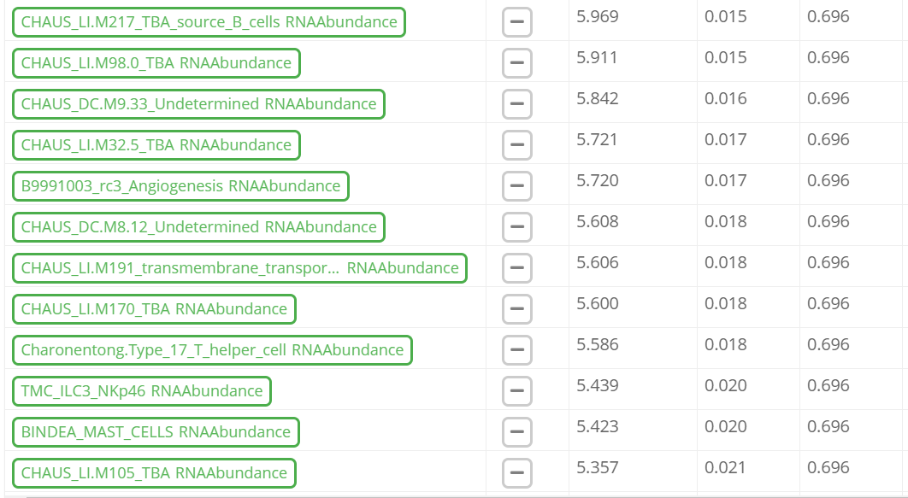

Ranked pathways within P2
Notes:
-Notch, mast cells (associated with immune checkpoint response), T-cells, B-cells, cell cycle, angiogenesis
-pathways were curated within literature or internal studies (Pfizer GeneSets v6)

Slide 19
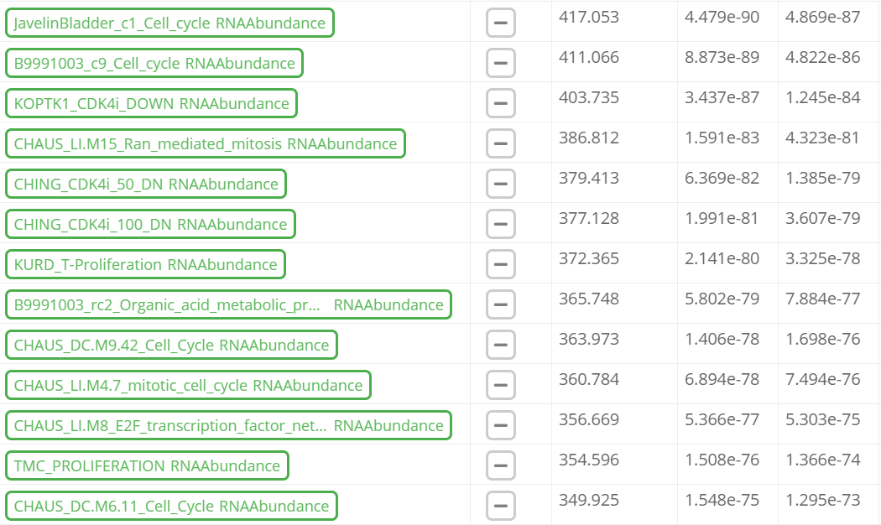
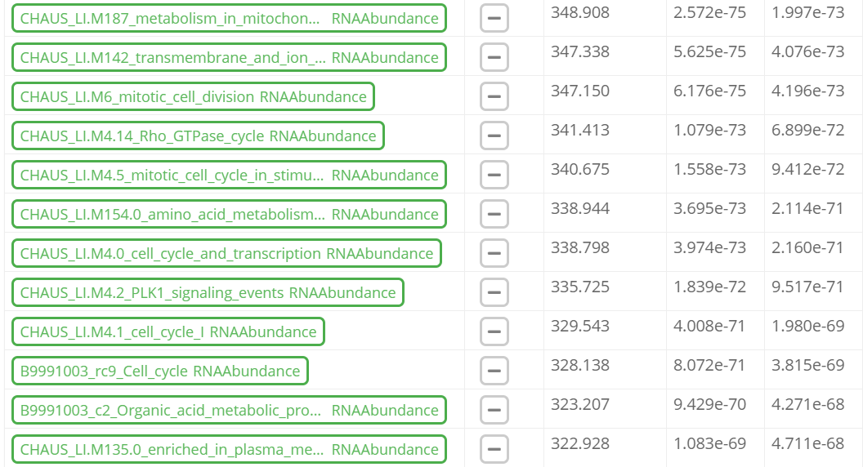
Ranked pathways for P2 compared to all other phenotypes
Notes:
-dominated by cell cycle

Slide 20
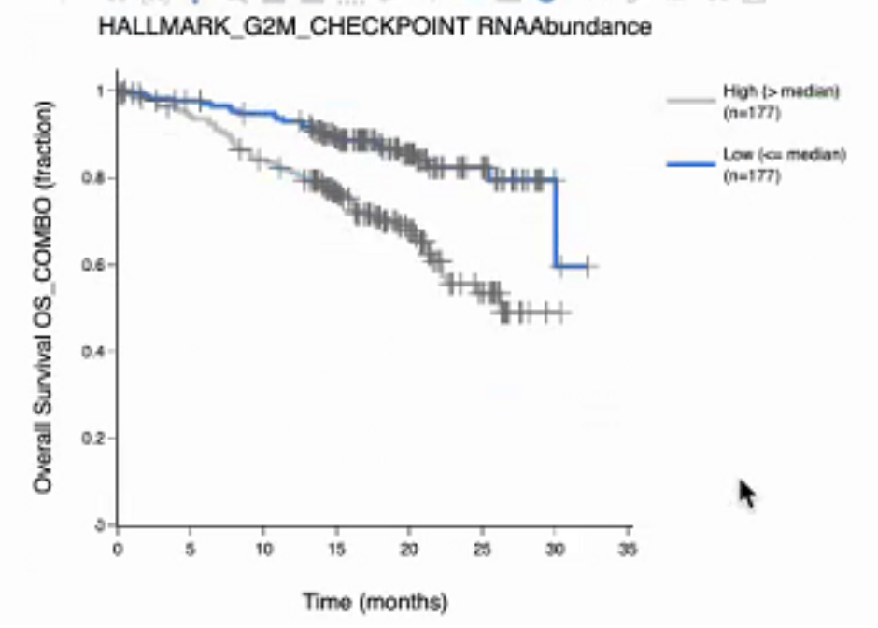
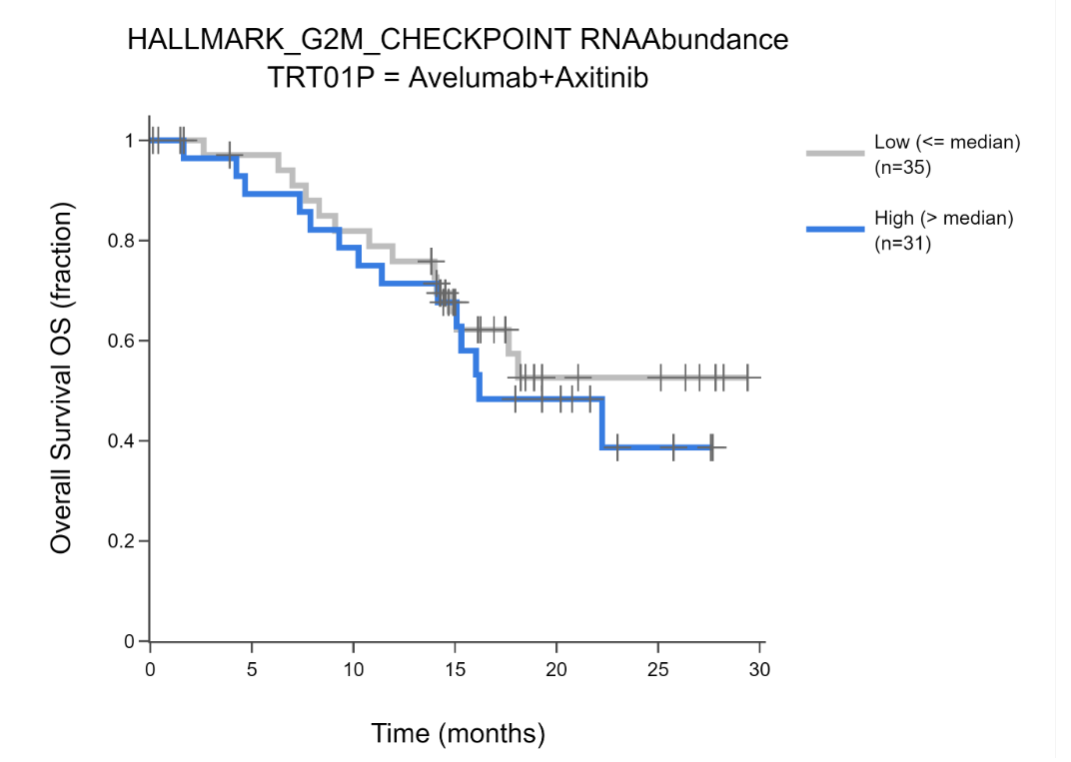
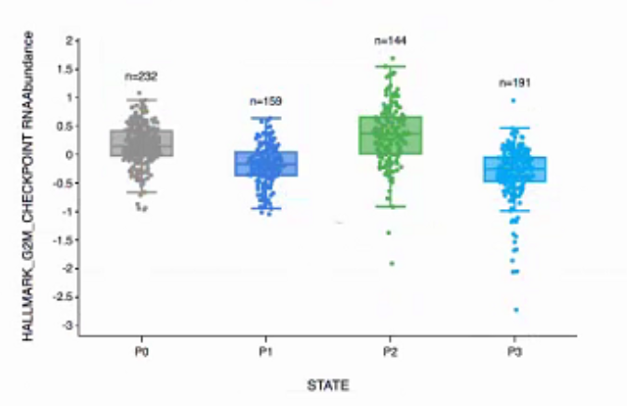
Cell cycle gene pathways are highly expressed in P2
Notes:
-cell cycle inhibitors such as Palbocyclib could be administered in combination with IO therapy to P2 Patients

Slide 21
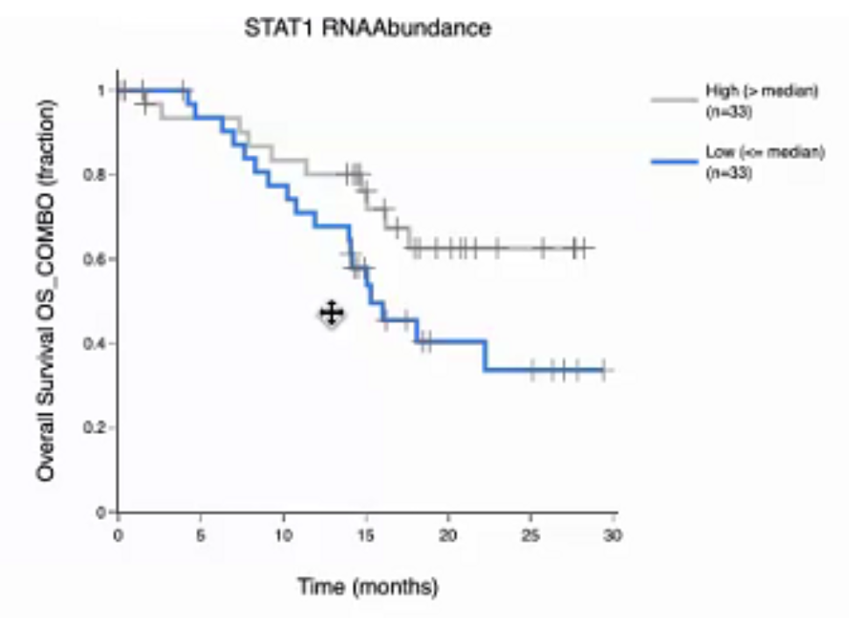
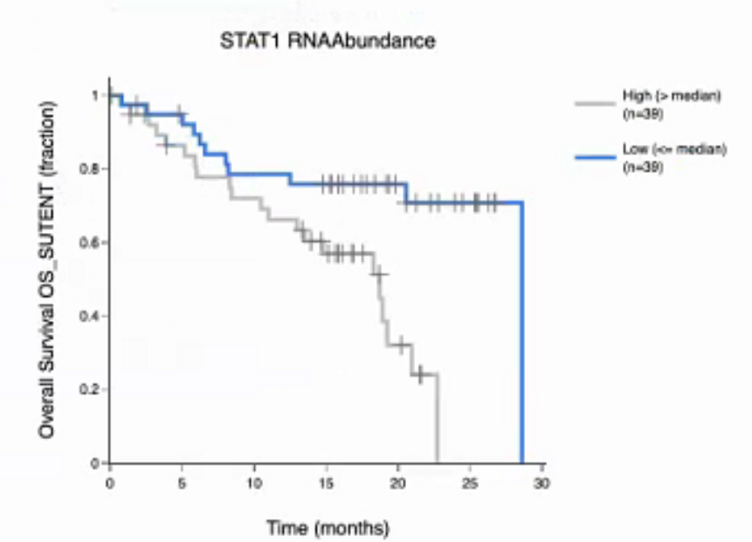
STAT1 (in the CRISPR IO Up List) is Under-Expressed in P2
Notes:
JAK STATs form a pathway for immune signaling for cytokines, JAK phosphorylates STAT, which are transcription factors

Slide 22
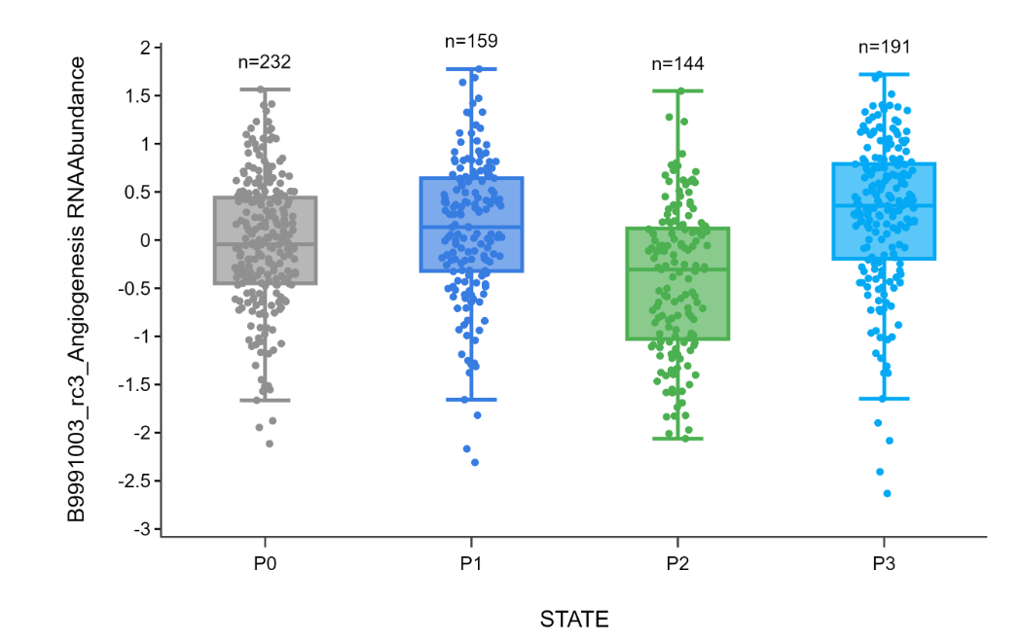
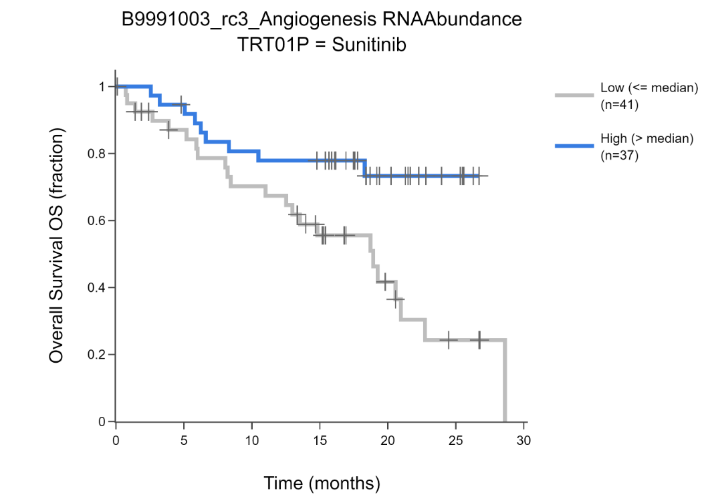
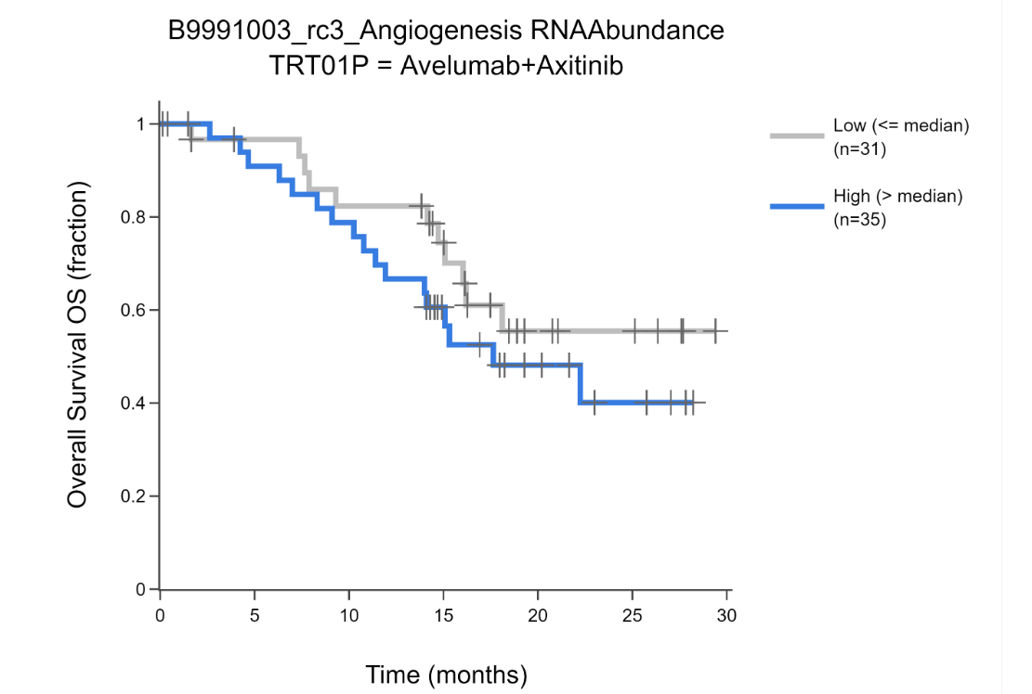
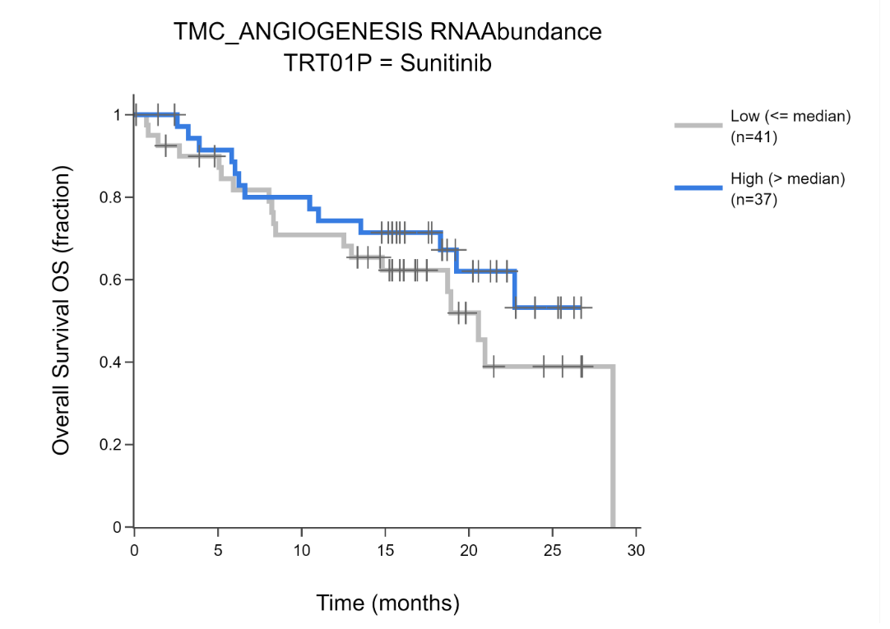
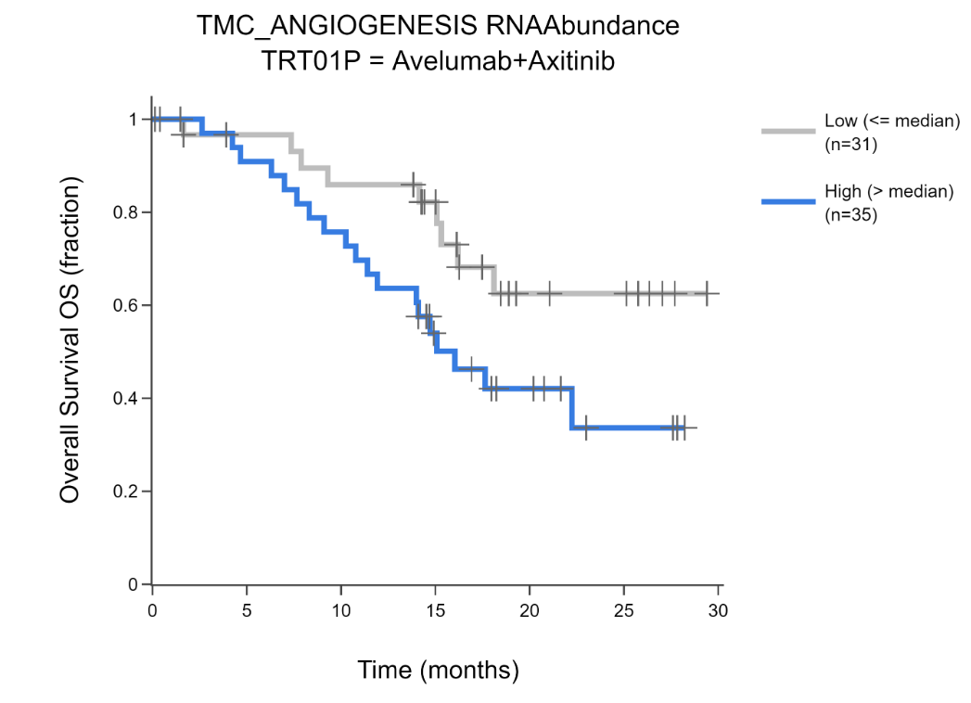
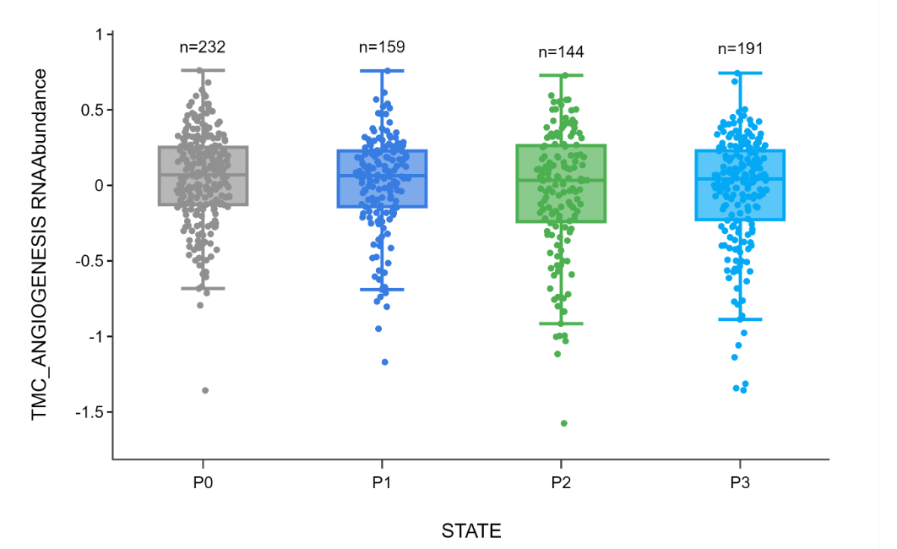
Notes:
Angiogenesis pathways are under-expressed in P2, B9991003 angiogenesis pathway has greater association between pathway expression level and patient survival

Slide 23
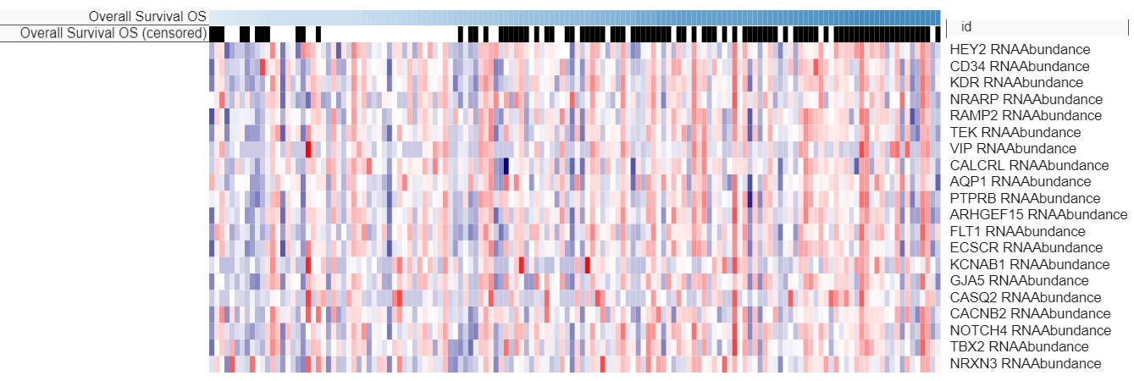
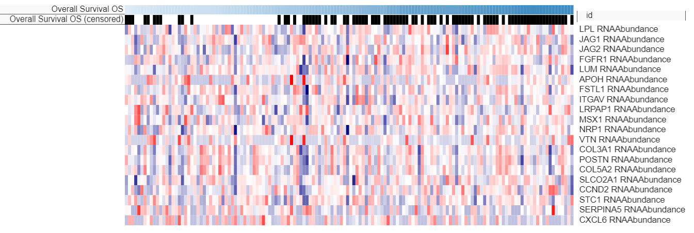
Comparing Angiogenesis Pathways
B9991003_rc3_Angiogenesis
B9991003_rc3_Angiogenesis
Notch receptor
Endothelium
VEGF receptors (FLT-1 and KDR, actual targets of Sunitinib)
Related to the vasculature itself
TMC_Angiogenesis
EMT Pathway: collagen and extracellular matrix
Ligands for Notch
Related to extracellular immunosuppressive microenvironment, doesn’t survive as well
TMC_Angiogenesis
Notes:
Collagen genes are associated with EMT transition because it remodels the vasculature

Slide 24
Summary
Results of CRISPR Screens can be aggregated to view genes and pathways that are involved in IO therapy
Allows you to look at effects of genes across multiple experiments
Significant genes and pathways in the aggregation can be investigated as potential drug targets
OncoGPS is a useful method for analyzing lists of significant genes by comparing the expression of those genes among patient samples
Allows us to look at results of CRISPR IO screens in the context of a clinical trial
Comparing OncoGPS Phenotypes in D4C allows us to discover additional biomarker trends related to treatment within specific subgroups of patients

